Slide 1
PCL 302
CNS DRUGS – ANTIEPILEPTIC DRUGS
DR R. ADISA
DEPARTMENT OF CLINICAL PHARMACY AND BIOPHARMACY

Slide 2
Learning outcome
At the end of this lecture, students should be able to provide comprehensive explanation on:
the general principles of treatment with AEDs
major classes of seizures
different AEDs in relation to the types of seizure
initiation of therapy in newly diagnosed epilepsy, and the maintenance doses
AED dosage adjustments, monitoring and follow-up
commonly prescribed AEDs and their peculiar features

Slide 3
Introduction
Epilepsy is a brain disorder characterised by an enduring predisposition to generate epileptic seizures
The annual incidence of epileptic seizures is around 50 cases per 100,000 of the population.
About 60–70% of those who develop epilepsy will become seizure free on treatment, and about 50% will eventually withdraw their medication successfully
Treatment of epilepsy is usually for at least 3 years and, depending on circumstances, sometimes for life. Medications used in the treatment of seizure/epilepsy are called antiepileptic drugs (AEDs)
Treatment aims to control seizures using one drug without causing side effects and minimising the use of polypharmacy
Management of epilepsy requires empowering the person to understand his or her condition and medication(s), and helping the person to develop effective partnerships with health professionals.

Slide 4
Introduction contd.
Epilepsy is a chronic neurological disorder that affects people of all ages
More than 50 million people worldwide have epilepsy
Nearly 80% of people with epilepsy are found in resource-poor settings
Epilepsy responds to treatment 70% of the time, however, despite this, approximately more than two-thirds of people affected in poor countries are not treated
People with epilepsy and their families suffer from stigma and discrimination in many parts of the world.

Slide 5
Brief recap on cause(s) of Epilepsy
Epileptic seizures are produced by abnormal discharges of neurons that may be caused by any pathological process which affects the cortical layer of the brain
The idiopathic or genetic epilepsies are those in which there is a clear genetic component, and they probably account for a third of all new cases of epilepsy
However, in a significant proportion of cases, no cause can be determined, and these are termed as unknown or cryptogenic epilepsies
- Possible explanations for unknown epilepsy include metabolic or biochemical abnormalities and microscopic lesions in the brain resulting from brain malformation or trauma during birth or other injury, (though, yet the link is not clearly explained or understood)
The hallmark of epilepsy is a rather rhythmic and repetitive hyper-synchronous discharge of neurones, either ‘localized’ in an area of the cerebral cortex or ‘generalized’ throughout the cortex, which can be observed on an electroencephalogram (EEG).
The clinical manifestation of a seizure will depend on the location of the focus and the pathways involved in its spread.
- If it involves initial activation of both hemispheres of the brain simultaneously, the seizures are termed ‘generalised’. If a discharge starts in a localised area of the brain, the seizure is termed ‘focal or partial
Lastly, seizures are classified as ‘unknown onset’ if it is not possible to classify as focal or generalised
However, there may be seizures that begin as partial/focal seizure but later become secondarily generalised

Slide 6
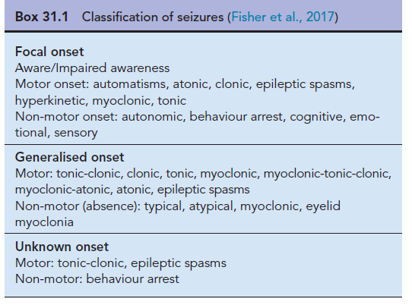
Recap of major classes of seizure is shown in the Table below

Slide 7
According to the International League Against Epilepsy (ILAE), epilepsy is defined by any of the following conditions:
1. At least two unprovoked (or reflex) seizures occurring more than 24 hours apart
2. One unprovoked seizure (or reflex) and a probability of further seizures similar to the general recurrence risk (at least 60%) after two unprovoked seizures, occurring over the next 10 years
3. Diagnosis of an epilepsy syndrome
A person with epilepsy will show recurrent epileptic seizures that occur unexpectedly and stop spontaneously

Slide 8
General principles of AEDs treatment
The primary aim of epilepsy treatment is to control seizures using one drug, with the lowest effective dose causing the fewest side effects possible
Established or the conventional AEDs licensed before 2000, are still an important part of the antiepileptic armamentarium, and these include carbamazepine, clobazam, clonazepam, ethosuximide, gabapentin, lamotrigine, phenobarbital, phenytoin, piracetam, primidone, sodium valproate, tiagabine, topiramate and vigabatrin.
The newer AEDs include eslicarbazepine acetate, brivaracetam, felbamate, lacosamide, levetiracetam, oxcarbazepine, perampanel, pregabalin, stiripentol, ruinamide and zonisamide have been introduced.
The choice of drugs depends largely on the seizure type, thus, correct diagnosis and classification are essential.

Slide 9
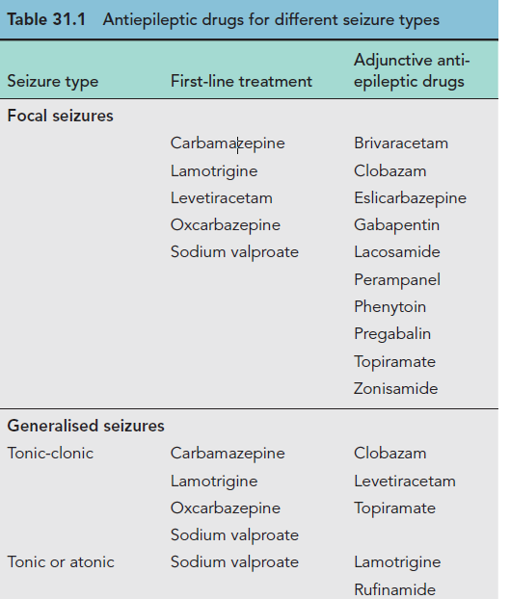

Slide 10
AEDs for different seizure types contd.
Seizure type | First-line treatment | Adjunctive AEDs
Absence | Ethosuximide | Clobazam
 | Lamotrigine | Clonazepam
 | Sodium valproate | Levetiracetam
 |  | Topiramate
 |  | Zonisamide
Myoclonic | Levetiracetam | Clobazam
 | Clonazepam
 | Piracetam

Slide 11
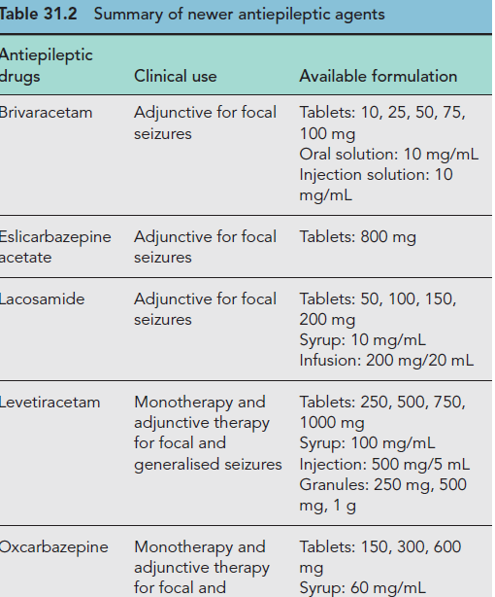

Slide 12
Summary of newer AEDs contd.
Antiepileptic drugs | Clinical use | Available formulation
Perampanal | Adjunctive for focal seizures | 10, 12mg
Pregabalin | Adjunctive for focal seizures | 25, 50, 75, 100, 150, 200, 225, 300mg; syrup 2mg/ml
Zonisamide | Monotherapy and adjunctive for focal seizures | Capsule 25, 50, 100mg

Slide 13
The Medicines and Healthcare products Regulatory Agency (MHRA) classified AEDs into three categories:
Category 1: phenytoin, carbamazepine, phenobarbital and primidone. People receiving these drugs should be maintained on a specific manufacturer’s product
Category 2: valproate, lamotrigine, perampanel, ruinamide, clobazam, clonazepam, oxcarbazepine, eslicarbazepine, zonisamide and topiramate. The need for continued supply of a particular manufacturer’s product is based on clinical judgement and consultation with the patient/career, taking into account factors such as seizure frequency and treatment history
Category 3: levetiracetam, lacosamide, tiagabine, gabapentin, pregabalin, ethosuximide and vigabatrin. It is usually unnecessary to maintain the patient on a specific manufacturer’s product

Slide 14
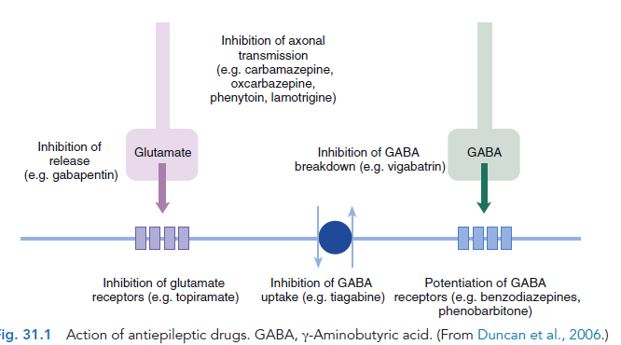

Slide 15
Initiation of therapy in newly diagnosed epilepsy
A first-line AED suitable for the person’s seizure type should be introduced slowly, starting with a small dose. A hasty introduction may induce side effects that may challenge the person’s confidence.
For most drugs, a gradual introduction will produce a therapeutic effect just as fast as a rapid introduction, and the person should be reassured about this.
Maintenance dosage
There is no single optimum dose of any AED that will suit all because the required dose varies from person to person and from drug to drug.
- Drugs are introduced slowly and then increased incrementally to an initial target dose
Seizure control should then be assessed, and the dose of drug changed if necessary.
For most AEDs, dosage increments are constant over a wide range, however, caution is needed with phenytoin because the serum level–dose relationship is not linear and small dose changes may result in considerable serum level changes

Slide 16
Most specialists would prefer people to remain on the same brand because it provides consistency. It is also preferred by the majority of people with epilepsy and is recommended by NICE
Different preparations of some AEDs may vary in bioavailability or pharmacokinetic profiles. This is an important consideration in those people in whom the dosage has been carefully titrated to achieve optimal control

Slide 17
Altering AED regimens
If the maximal tolerated dose of an AED does not control seizures or if it is not tolerated, the first drug should be replaced with another first-line AED, and the second drug should be added gradually to the first.
- Once a good dose of the new drug is established, the first drug should then slowly be withdrawn.
Withdrawal/stopping of AEDs
AEDs should not be withdrawn abruptly, but withdrawal of individual AEDs should be carried out in a slow, stepwise fashion to avoid the precipitation of rebound seizures (e.g. over 2–3 months).
Withdrawing therapy should be considered in people who have been seizure free for a considerable period. However, in no individual case, can the safety of drug withdrawal be guaranteed
The risk of relapse on withdrawal of medication in a person who has been seizure free for more than 2 years is about 40%
- The risk is particularly great with barbiturates (phenobarbital and primidone) and benzodiazepines (clobazam and clonazepam)
If a drug needs to be withdrawn rapidly, for example, if there are life-threatening side effects, a benzodiazepine can be used to cover the withdrawal phase

Slide 18
The longer the person has been free of seizures, the lower the risk of seizure recurrence when drugs are withdrawn
If a person has a learning disability, focal seizures or symptomatic epilepsy, neurological signs or other evidence of cerebral damage, the risk is much higher, and in such cases it may be best to continue drug treatment indefinitely.
Drug withdrawal should be carried out only very slowly in staged decrements, and only one drug at a time should be withdrawn.
Examples of withdrawal regimens are given below:
Carbamazepine
-100–200 mg every 2 weeks (as part of a drug change)
- 100–200 mg every 4 weeks (total withdrawal)
• Phenobarbital
15–30 mg every 2 weeks (as part of a drug change)
15–30 mg every 4 weeks (total withdrawal)

Slide 19
• Phenytoin
50 mg every 2 weeks (as part of a drug change)
50 mg every 4 weeks (total withdrawal)
• Sodium valproate
200–400 mg every 2 weeks (as part of a drug change)
200–400 mg every 4 weeks (total withdrawal)
• Ethosuximide
125–250 mg every 2 weeks (as part of a drug change)
125–250 mg every 4 weeks (total withdrawal)
However, variations in the regimens may be accommodated/used in different settings
People must be monitored closely for any change in seizure frequency
The pace of withdrawal may be slower if the person is within the higher end of the quoted dose range and faster if the person is an in-patient.

Slide 20
The risks of AEDs withdrawal should be clearly explained to the person, and the possible medical and social implications taken into account
Generally, the decision to withdraw therapy is an individual one, and the person should be made aware of the risks and benefits of withdrawal
Newer antiepileptic drugs
The newer AEDs are generally used as second-line drugs when treatment with established first-line drugs has failed. Exceptions to this are levetiracetam and oxcarbazepine.
Overall, newer AEDs are not more effective than the established drugs but seem to be better tolerated.
Notwithstanding, the chronic side effect profile of the new AEDs has not yet been fully established.

Slide 21
Follow-up and monitoring of treatment
It is essential to follow up patients in whom AED treatment has been started, so as to monitor the efficacy and side effects of treatment, upon which drug dosage will depend, and also to encourage good adherence.
Follow-up is particularly important in the early stages of treatment, especially (i) when an effective maintenance dose may not have been fully established, (ii) when the importance of adherence may not have been recognized by the person and (iii) when the psychological adjustment to regular treatment may not be resolved.
TDM is an integral component in the management of patients who are taking phenytoin and carbamazepine, especially, but is less useful in those receiving other AEDs
TDM has a very limited use for new AEDs, except in patients who are acutely unwell, pregnant or in the elderly
It is also very useful to document AED side effects and in managing drug interactions
Adherence may also be a problem in patients on AEDs, and hence TDM may be useful to establish treatment adherence

Slide 22
TDM is indicated:
at the onset of therapy, if seizure control is poor or sudden changes in seizure control occur, if toxicity is suspected, if poor or non-adherence is suspected, a person’s drug regimen that may interact with the AED.
Assessment
The diagnosis of epilepsy should be reassessed before assuming seizures are intractable because misdiagnosis is common. Progressive neurological conditions should also be ruled out.
A treatment history should be obtained and note made of previous AEDs used which were helpful, unhelpful or of uncertain benefit.
Serum level measurements should be obtained where appropriate, and drugs not previously tried should be identified.

Slide 23
Choice of AEDs and dosage
Treatment should always be started with one AED appropriate for seizure type and suitable for the individual
Only when attempts at monotherapy fail should a combination of two AEDs be tried. In the majority of people, there is no place for therapy with more than two drugs
The choice of drugs should be made according to seizure type and previous treatment history
Drugs that were helpful in the past or found to be of uncertain benefit, or which have not been used before, should be tried if appropriate to seizure type. The use of sedative AEDs should be minimised where possible

Slide 24
COMMONLY PRESCRIBED AEDs
Carbamazepine
Carbamazepine is a first-line drug for generalised tonic-clonic seizures and focal seizures.
It is not effective in absence seizures and myoclonic seizures, where it may even be deleterious.
Carbamazepine acts through blockage of voltage-gated sodium channel.
Tolerance to its beneficial effect does not usually develop.
Adverse events may occur in up to a third of people treated with carbamazepine, but only about 5% of these events will require drug withdrawal, usually because of skin rash, gastro-intestinal disturbances or hyponatraemia.
Dose-related adverse reactions including ataxia, dizziness, blurred vision and diplopia are common.
Idiosyncratic reactions, such as skin rash, occur in up to 10%, but rarely cause severe skin eruptions as erythema multiform and Stevens–Johnson syndrome.
Others serious adverse events including hepatic failure and bone marrow depression are extremely uncommon.

Slide 25
Carbamazepine contd.
Carbamazepine exhibits auto-induction, i.e. induces its own metabolism as well as inducing the metabolism of other drugs
- It should, therefore, be introduced at low dosage, and this should be steadily increased over a period of a month
The target serum concentration therapeutic range is 4 -12 micrograms/mL. A number of clinically important pharmacokinetic interactions may occur, and caution should be exercised when co-medication is instituted
The slow-release preparation of carbamazepine has distinct advantages, such as allowing twice-daily ingestion and avoiding high peak serum concentrations.
A ‘chewtab’ formulation is also available, and pharmacokinetic studies have shown that it performs well even if inadvertently swallowed whole.
Carbamazepine retard reduces fluctuations of serum levels and allows a twice-daily regimen, which can assist adherence.

Slide 26
Ethosuximide
Ethosuximide is a drug of first choice for generalised absence seizures, but has no useful effect against any other seizure type.
Its mechanism of action is through blockage of low-voltage activated calcium channel
Tolerance does not seem to be a problem
The most commonly encountered adverse effects are gastrointestinal symptoms, which occur frequently at the beginning of therapy. Behaviour disorders, anorexia, fatigue, sleep disturbances and headaches may also occur.
Idiosyncratic side effects include rash, Stevens–Johnson syndrome and aplastic anaemia
The therapeutic range commonly quoted is 1–1.5 g daily in two divided doses, increased if necessary up to 2 g daily.
The initial dosage is 500 mg daily in two divided doses and increased in steps of 250 mg every 5–7 days.
The absorption of ethosuximide is complete, and the bioavailability of the syrup and capsule formulations is equivalent. An increase in daily dose may lead to disproportionately higher increases in average serum concentrations; therefore, careful monitoring is indicated at high doses.

Slide 27
Phenytoin
In current practice, phenytoin is a second-line drug for focal seizures, tonic-clonic seizures, as well as atonic seizures and atypical absences. It is not effective in typical generalized absence and myoclonic seizures, where it may even be deleterious.
It acts through blockage of voltage-gated sodium channel
Tolerance to its antiepileptic action does not usually occur
Phenytoin has non-linear kinetics and a low therapeutic index, and in some patients frequent drug serum level measurements may be necessary. Drug interactions are common, because phenytoin metabolism is very susceptible to inhibition by some drugs, whereas it may enhance the metabolism of others. Caution should be exercised when other medication is introduced or withdrawn.
Effective dosages are between 200 and 500 mg/day.

Slide 28
Phenytoin contd.
Adverse events may occur in up to a half of those treated with phenytoin, but only about 10% will necessitate drug withdrawal, most commonly because of skin rash. Dose-related adverse reactions including nystagmus, ataxia and lethargy are common.
Cosmetic effects such as gum hypertrophy, hirsutism and acne are well-recognised adverse effects and should be taken into account when prescribing for children and young women.
Chronic adverse effects include folate deiciency, osteomalacia, Dupuytren’s contractures and cerebellar atrophy. Serious idiosyncratic adverse events, including hepatic failure and bone marrow depression, are extremely uncommon.

Slide 29
Sodium valproate
Sodium valproate is a broad-spectrum AED, effective over the complete range of seizures type, but with particular value in the idiopathic generalised epilepsies. This is mainly due to its broad mechanism of action, known to act on voltage-gated sodium and calcium channels, and also in the turnover of GABA.
Tolerance to its antiepileptic action does not usually occur. Drug interactions with other AEDs may be problematic
Phenobarbital levels increase following co-medication with valproate, and a combination of these two drugs may result in severe sedation. Sodium valproate may also inhibit the metabolism of lamotrigine, phenytoin and carbamazepine.
Enzyme inducing drugs enhance the metabolism of sodium valproate, so caution should be exercised when other AEDs are introduced or withdrawn.

Slide 30
Sodium valproate contd.
The usual therapeutic range quoted is 1- 2 g daily with a maximum dosage of 2.5 g/day.
Because of the lack of a good correlation between total valproate concentrations and effect, serum level monitoring of the drug has limited use.
TDM should only be performed in cases of suspected toxicity, deterioration in seizure control, to check adherence or to monitor drug interactions.
Sodium valproate is more teratogenic than other commonly used AEDs and should be avoided in women of childbearing age

Slide 31
Phenobarbital
Phenobarbital, a barbiturate, may be used for the treatment of tonic-clonic and focal seizures, and it may also be used in other seizure types
As with other barbiturates, it acts through activation of the ionotropic GABA receptor
Its antiepileptic efficacy is similar to that of phenytoin or carbamazepine
Adverse effects on cognitive function, the propensity to produce tolerance and the risk of serious seizure exacerbation on withdrawal make it an unattractive option, and it should be used only as a last resort.
In addition to cognitive effects, barbiturates may cause skin rashes, ataxia, folate deficiency, osteomalacia, behavioural disturbances (particularly in children) and an increased risk of connective tissue disorders such as Dupuytren’s contracture and frozen shoulder.
Phenobarbital is a potent enzyme inducer and is implicated in several clinically important drug interactions

Slide 32
Gabapentin
Gabapentin is occasionally used as a second-line treatment of focal seizures Although initially developed as an AED, its main use currently is for the treatment of neuropathic pain.
It exerts its effect through blockage of high-voltage activated calcium channels
In view of its pharmacokinetic profile, a three times daily dosage must be used; the usual dosage is 0.9 - 3.6 g daily.
It should be started with 300 mg once daily on day 1,then 300 mg twice daily on day 2 and then 300 mg three times a day on day 3.
To date, no clinically significant interactions with other AEDs, or other drugs, have been reported.
The most frequently reported side effects are drowsiness, dizziness, diplopia, ataxia and headache.
Idiosyncratic effects include increasing seizures.

Slide 33
Lamotrigine
Lamotrigine is a first-line drug for patients with focal and generalised seizures
Its main action is through blockage of voltage-gated sodium channel
Lamotrigine does not seem to interact with other concomitantly administered AEDs, however, hepatic enzyme inducers increase the metabolism of lamotrigine, reducing its half-life
Therefore, higher doses need to be administered if it is used in conjunction with enzyme inducers such as phenytoin and carbamazepine.
Inhibitors of hepatic enzymes such as sodium valproate block the metabolism of lamotrigine, and reduced doses needed to be used if both drugs are given in combination.
The recommended starting dosage is 25 mg once daily when used as monotherapy and 25 mg on alternate days in patients receiving concomitant sodium valproate, with a maximum recommended dosage of 500 mg daily, but no more than 200 mg daily if concomitant to valproate
It should be increased by 25 mg in 14-day intervals, as too rapid titration may be associated with an increased incidence of skin rash.
Headaches, drowsiness, ataxia and diplopia are the most commonly reported acute adverse effects, particularly during dose escalation. A skin rash is the commonest idiosyncratic side effect

Slide 34
Levetiracetam
Levetiracetam is a broad-spectrum drug, indicated both as a first-line and as an add-on for the treatment of focal and generalized seizures
Mechanism of action is not fully understood, but it binds to the synaptic vesicle protein 2A
The usual dosage is between 1000 and 3000 mg/day, divided in two daily doses. It is usually started at 250 mg once daily for 1–2 weeks, then increased to 250 mg twice daily and then titrated upwards in incremental steps of 250 mg twice daily every 2 weeks.
- It is well tolerated, and the most frequent central nervous system adverse events are dizziness, irritability, asthenia, insomnia and ataxia.
No idiosyncratic adverse events have yet been reported.

Slide 35
Pregabalin
Pregabalin has been licensed for the adjunctive treatment of refractory focal epilepsy. It is closely related to gabapentin and a structural analogue of the neurotransmitter GABA but does not seem to affect transmitter response.
It modulates calcium channels by binding to a subunit of Ca2+, and this action is thought to be the basis of its antiepileptic mechanism.
The recommended doses for pregabalin are between 150 and 600 mg divided into two doses, although some patients may respond to doses outside this range.
Pregabalin is normally started at 25 mg twice daily and increased in incremental steps of 50 mg daily every week up to 600 mg daily in two to three divided doses according to clinical need.
Overall, pregabalin is well tolerated, and so far no idiosyncratic side effects have been described. Dizziness, drowsiness, ataxia, tremor and diplopia are the most common side effects. Weight gain occurs particularly with higher doses.
No pharmacokinetic interactions have yet been identified.
In addition to its use in epilepsy, pregabalin has also been indicated for neuropathic pain and generalised anxiety disorders.

Slide 36
Topiramate
Topiramate is chemically unrelated to other AEDs and is a used as a first-line drug for patients with focal seizures with or without secondary generalisation and for generalised seizure.
It has multiple mechanism of action: voltage-gated sodium and calcium channels, GABA and glutamate receptors
Recommended dosages are between 75 and 300 mg/day. It has to be titrated slowly, starting with a dosage of 25mg once daily, titrating upwards in 25 to 50 mg increments every 1 - 2 weeks up to a usual dosage of 100 - 200 mg daily in two divided doses.
- The maximum dosage is 500 mg/day in monotherapy or 400 mg/day as adjunctive therapy. It has no clinically significant interactions with other AEDs, although hepatic enzyme inducers accelerate its metabolism and doses need to be adjusted downwards if the patient is coming off carbamazepine or phenytoin.
Side effects include dizziness, drowsiness, irritability, impaired concentration, paraesthesias, nephrolithiasis and fatigue. People starting topiramate should increase their luid intake to reduce the risk of kidney stones. Weight loss is seen in up to 40% of those who are taking topiramate

Slide 37
Vigabatrin
Vigabatrin inhibits GABA degradation, but because of a poor safety profile it is a last resort drug for focal seizures
It is still a first-line treatment of infantile spasms, particularly if associated with tuberous sclerosis.
Vigabatrin does not interact with other drugs apart from decreasing phenytoin levels, probably by blocking its absorption.
The most common adverse events associated with vigabatrin are behavioural disturbances, ranging from agitation to frank psychosis and visual field defects, which had been associated with long-term treatment in up to 40–50% of patients.
Other known adverse effects include drowsiness, headaches, ataxia, weight gain, depression and tremor. Careful monitoring for side effects, particularly ophthalmological, on initiation of therapy is essential.

Slide 38
Recent and future evidence for antiepileptic drugs
In adults with focal-onset seizures, carbamazepine, levetiracetam, phenytoin and zonisamide have level A evidence (highest supporting level of clinical trial evidence)
Only oxcarbazepine has level A for children with focal-onset seizures, and gabapentin and lamotrigine have that level for the elderly with the same seizure type
There is no drug with level A evidence for generalised-onset tonic-clonic seizures in adults or in children. However, ethosuximide and valproic acid have level A evidence in children with childhood absence epilepsy
The new AEDs are still not capable of achieving the primary goal of epilepsy treatment complete freedom of seizures. Although, some may have a more favourable profile, with lesser drug interactions and side effects. As such, this group of drugs will probably continue to expand, with new AEDs appearing in the quest of epilepsy cure.

Slide 39
Status epilepticus
Status epilepticus is traditionally defined as ongoing seizure activity for ≥30 minutes, but from a pragmatic point of view, a seizure that lasts longer than 5 minutes warrants pharmacological intervention.
Initial management of status epilepticus is supportive and may include:
secure airway and resuscitate,
administer oxygen,
assess cardiorespiratory function,
establish intravenous access
Buccal midazolam (10 mg) is first-line treatment in the community. Rectal diazepam is an alternative if preferred or if buccal midazolam is not available. If intravenous access is already established and resuscitation facilities are available, intravenous lorazepam is administered.
First-line AED for hospital management of status epilepticus is intravenous lorazepam. If unavailable, then intravenous diazepam should be administered or buccal midazolam if immediate intravenous access cannot be secured.
If seizures continue, intravenous phenytoin or valproate or phenobarbital should be administered as second-line treatment.
In the refractory status, general anaesthesia with propofol, midazolam or thiopentone may be necessary.

Slide 40
THE END

